Slide 1

java Programming Project Presentation
Project Title: Digital Note Organizer with File Storage
Course: java Programming Mini Project
Student Name & Roll No: Santhanalakshmi, 25bcs145
Department: Computer Science
Mentor / Guide: Mr. Aravind

Slide 2
Introduction
java Programming Project Presentation
A Digital Note Organizer with File Storage is an application used to create, store, and manage notes digitally. It helps users organize information efficiently and access files easily through a simple and user-friendly interface.
The application is developed using Java Swing, offering a user-friendly interface for smooth interaction. This project demonstrates how technology can simplify everyday tasks like note-taking and file management.

Slide 3
Objective
java Programming Project Presentation
The objective of this project is to develop a user-friendly application that allows users to create, organize, and store notes along with files digitally, making information management easy, secure, and efficient.
It also ensures quick access, better data management, and a more convenient way to handle daily notes and documents.

Slide 4
Problem Statement
java Programming Project Presentation
Managing notes and important files manually or across scattered digital tools is time-consuming, disorganized, and prone to loss. There is a need for a simple, secure, and centralized system to efficiently create, store, and access notes and files.
Existing systems lack a centralized, secure, and easy-to-use platform for notes and file management.

Slide 5
System Requirements
Java Programming Project Presentation
Hardware Requirements:
. Hard Disk (minimum 500 GB)
.Keyboard and Mouse
Software Requirements:
• IDE: NetBeans / Eclipse
• Java Development Kit (JDK)

Slide 6
System Design
java Programming Project Presentation
User Interface Layer: Provides a simple and user-friendly GUI using Java Swing for creating, editing, and viewing notes.
Application Layer: Handles note management, file storage, and data operations.
Data Storage Layer: Saves notes and files securely in a structured format on the local system.
Flow: User inputs → Application processes → Data stored/retrieved → Display output on GUI.

Slide 7
Module Description
java Programming Project Presentation
.Input Module: Allows users to create, edit, and enter notes or attach files.
.File Handling Module: Saves, retrieves, and manages notes and files securely.
.Processing Module: Organizes, searches, and updates notes and files as per user actions.
.Output Module: Displays notes and files in a user-friendly interface for easy access.

Slide 8
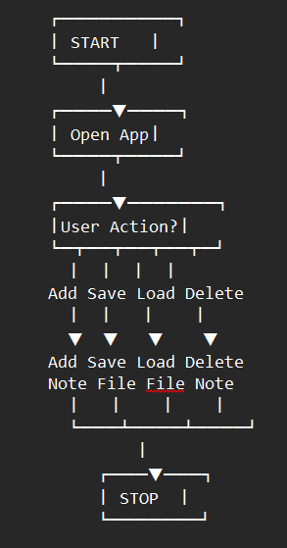
Algorithm / Flowchart
java Programming Project Presentation
1. Start
2. Initialize variables
3. Input data from the user
4. Process data
5. Display output
6. Stop
(Insert flowchart image here)

Slide 9
Implementation
Java Programming Project Presentation
Techniques Used:
.Loops and conditional statements for menu and navigation
.Functions for modular design (add, edit, delete, search notes)
.Arrays to store notes temporarily in memory
.File handling (fopen, fclose, fprintf, fscanf) to save and retrieve notes and files

Slide 10
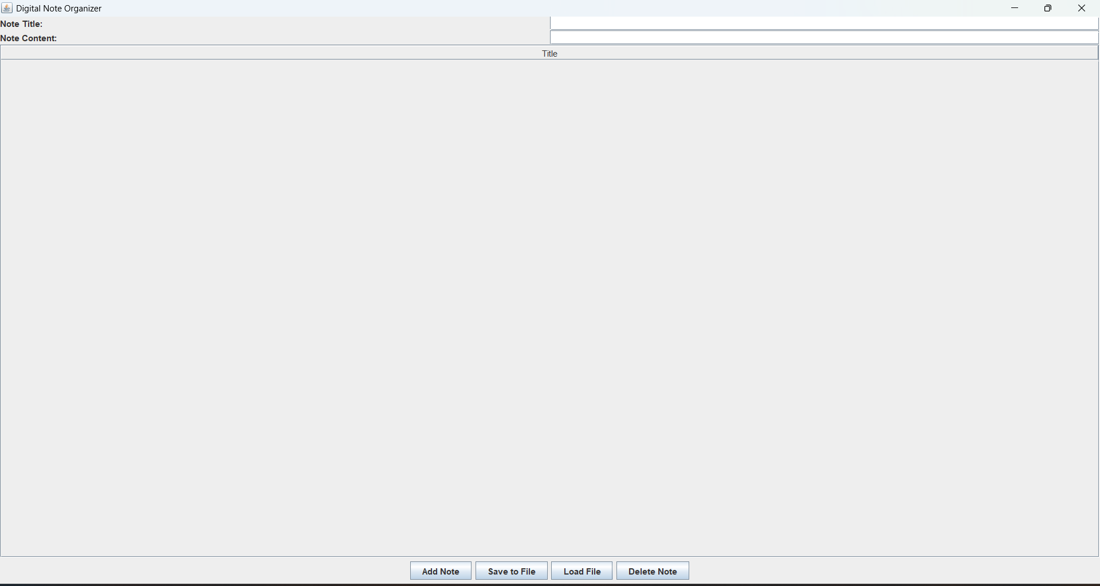
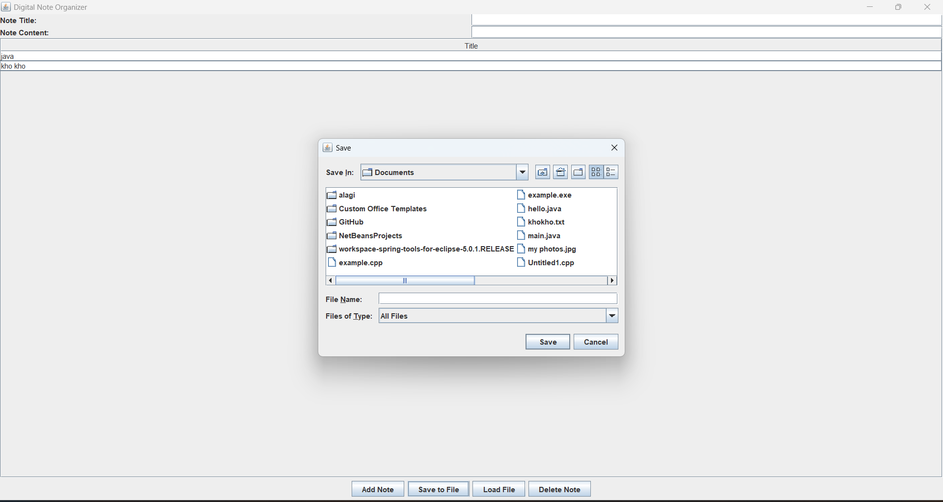
Output Screens
java Programming Project Presentation

Slide 11
Results & Discussion
java Programming Project Presentation
Results:
The application allows users to add, save, load, and delete notes successfully.
Notes are stored in a file and displayed properly in the table.
Discussion:
The system is simple and easy to use with Java Swing and file handling.
It can be improved by storing full content and adding more features.

Slide 12
Conclusion & Future Enhancement
java Programming Project Presentation
Conclusion
The Digital Note Organizer successfully manages notes and stores them using file handling.
This project helps in understanding Java Swing, file operations, and basic system design.
Future Enhancement
Add more features like saving full note content and search option.
Improve the system using a database and better user interface.

Slide 13
References / Acknowledgement
java Programming Project Presentation
References:
.Java: The Complete Reference – Herbert Schildt
.Java Programming Books
.W3Schools-java Basics and Emamples
Acknowledgement:
I thank my teacher and college for giving me this opportunity to do this project.
I also thank my friends and online resources for their support.

Slide 14
Thank You

